Slide 1

Project 3: Image Geolocalization
Machine learning and Deep learning AA 2022/2023
Teaching Assistant: Carlo Masone (carlo.masone@polito.it)
Gabriele Berton(gabriele.berton@polito.it) Gabriele Trivigno (gabriele.trivigno@polito.it)

Slide 2
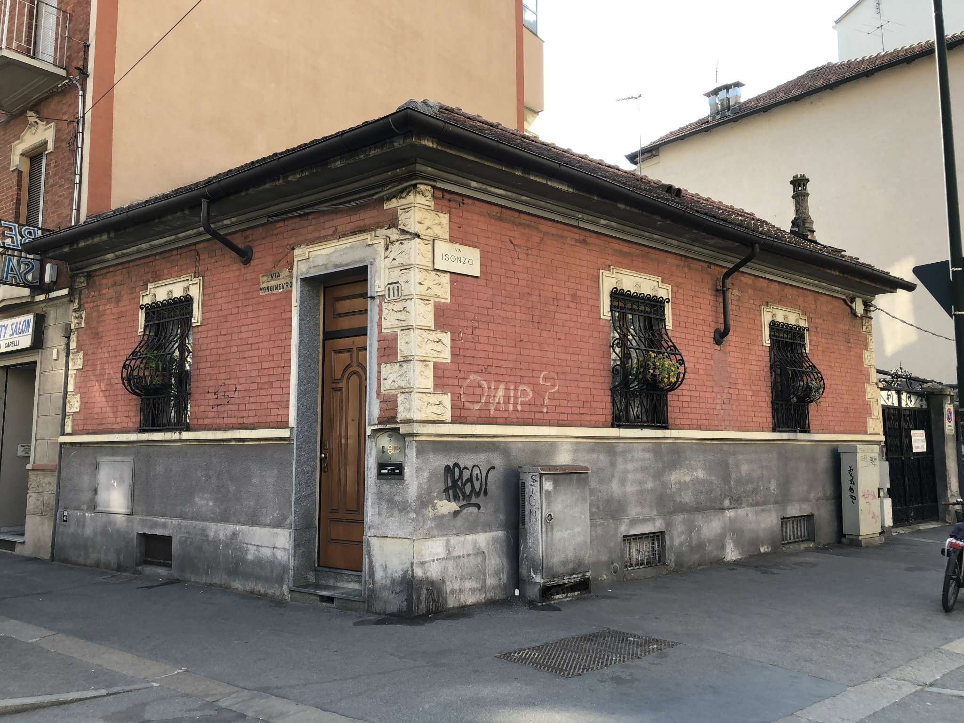


What is Image Geolocalization
Visual Geolocalization:
The objective is to correctly understand the location depicted in the query image based only on visual clues.
Via Roma, 161, 10123 Torino TO
INPUT
OUTPUT
Input image -> query

Slide 3
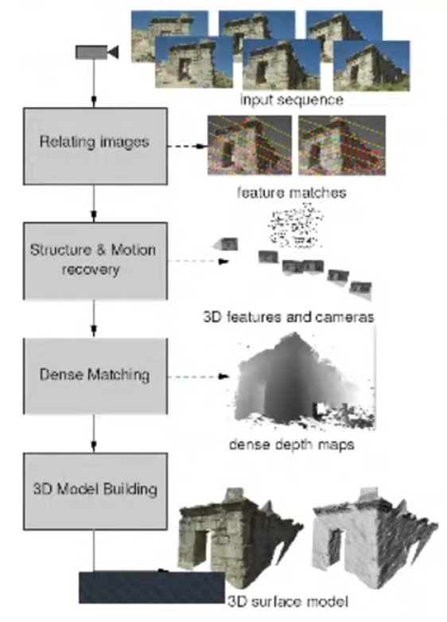
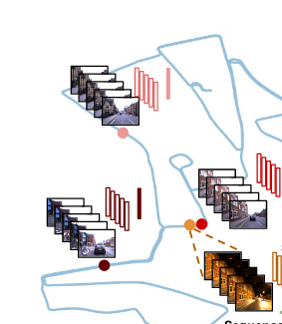
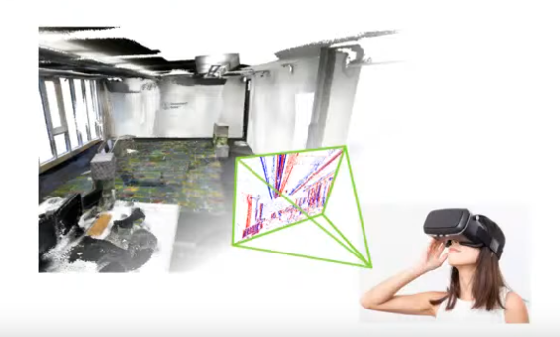
Applications
Augmented reality
3D reconstruction
SLAM

Slide 4
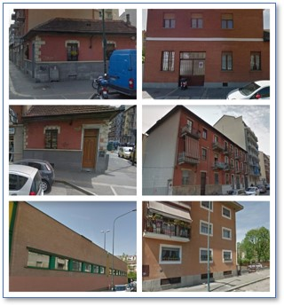
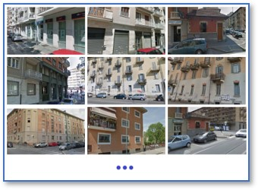
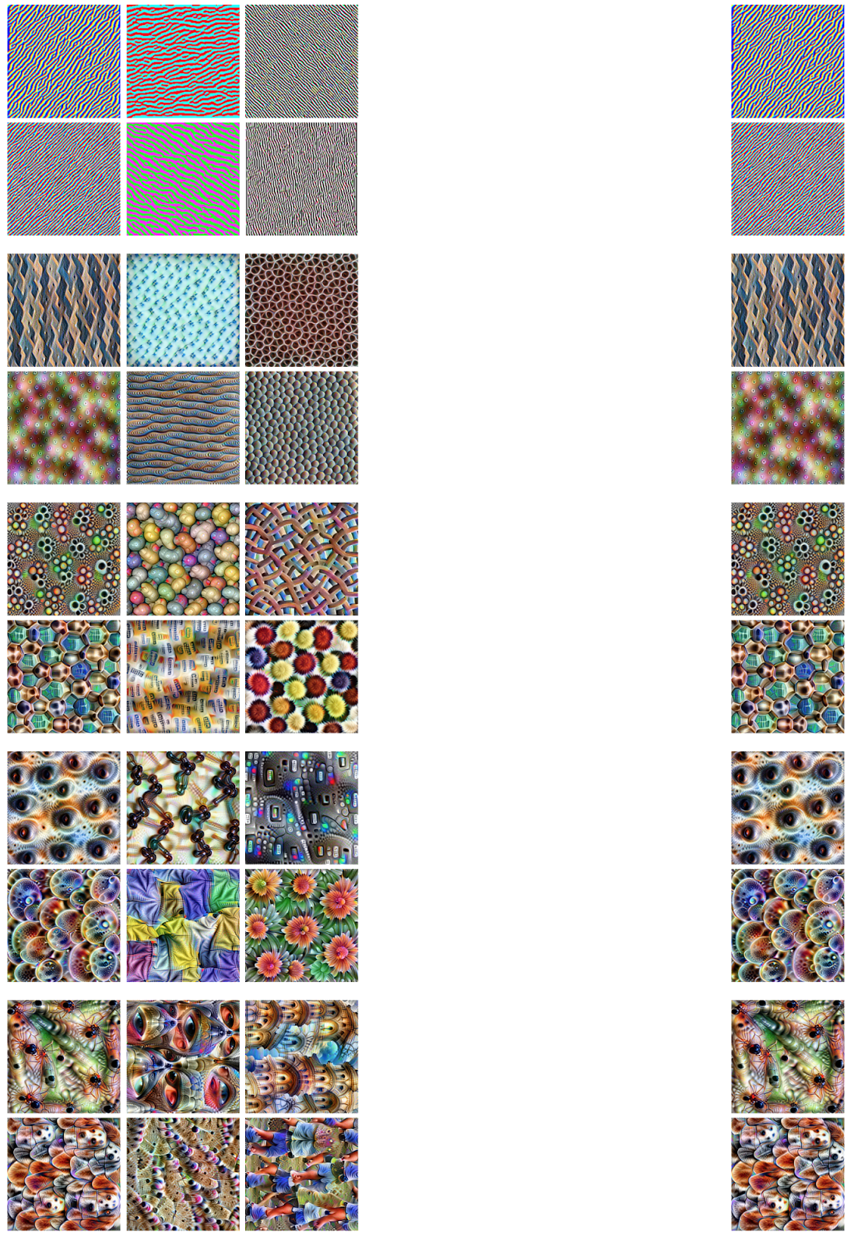
How to approach Image Geolocalization
Image retrieval process:
QUERY
VISUAL FEATURES
AGGREGATED FEATURES
RESULTS
FEATURES
EXTRACTION
FEATURES
AGGREGATION
01001001
SIMILARITY
RESEARCH
(kNN)
FEATURES
EXTRACTION
FEATURES
AGGREGATION
10011011
00111011
01101011
...
. . .
AGGREGATED FEATURES
VISUAL FEATURES
DATABASE IMAGES

Slide 5
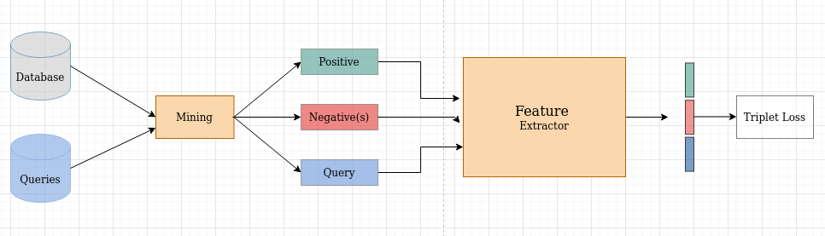
How to train Image Retrieval networks
Contrastive learning
Positive
Learning
Query
Positive
Query
Negative
Negative

Slide 6
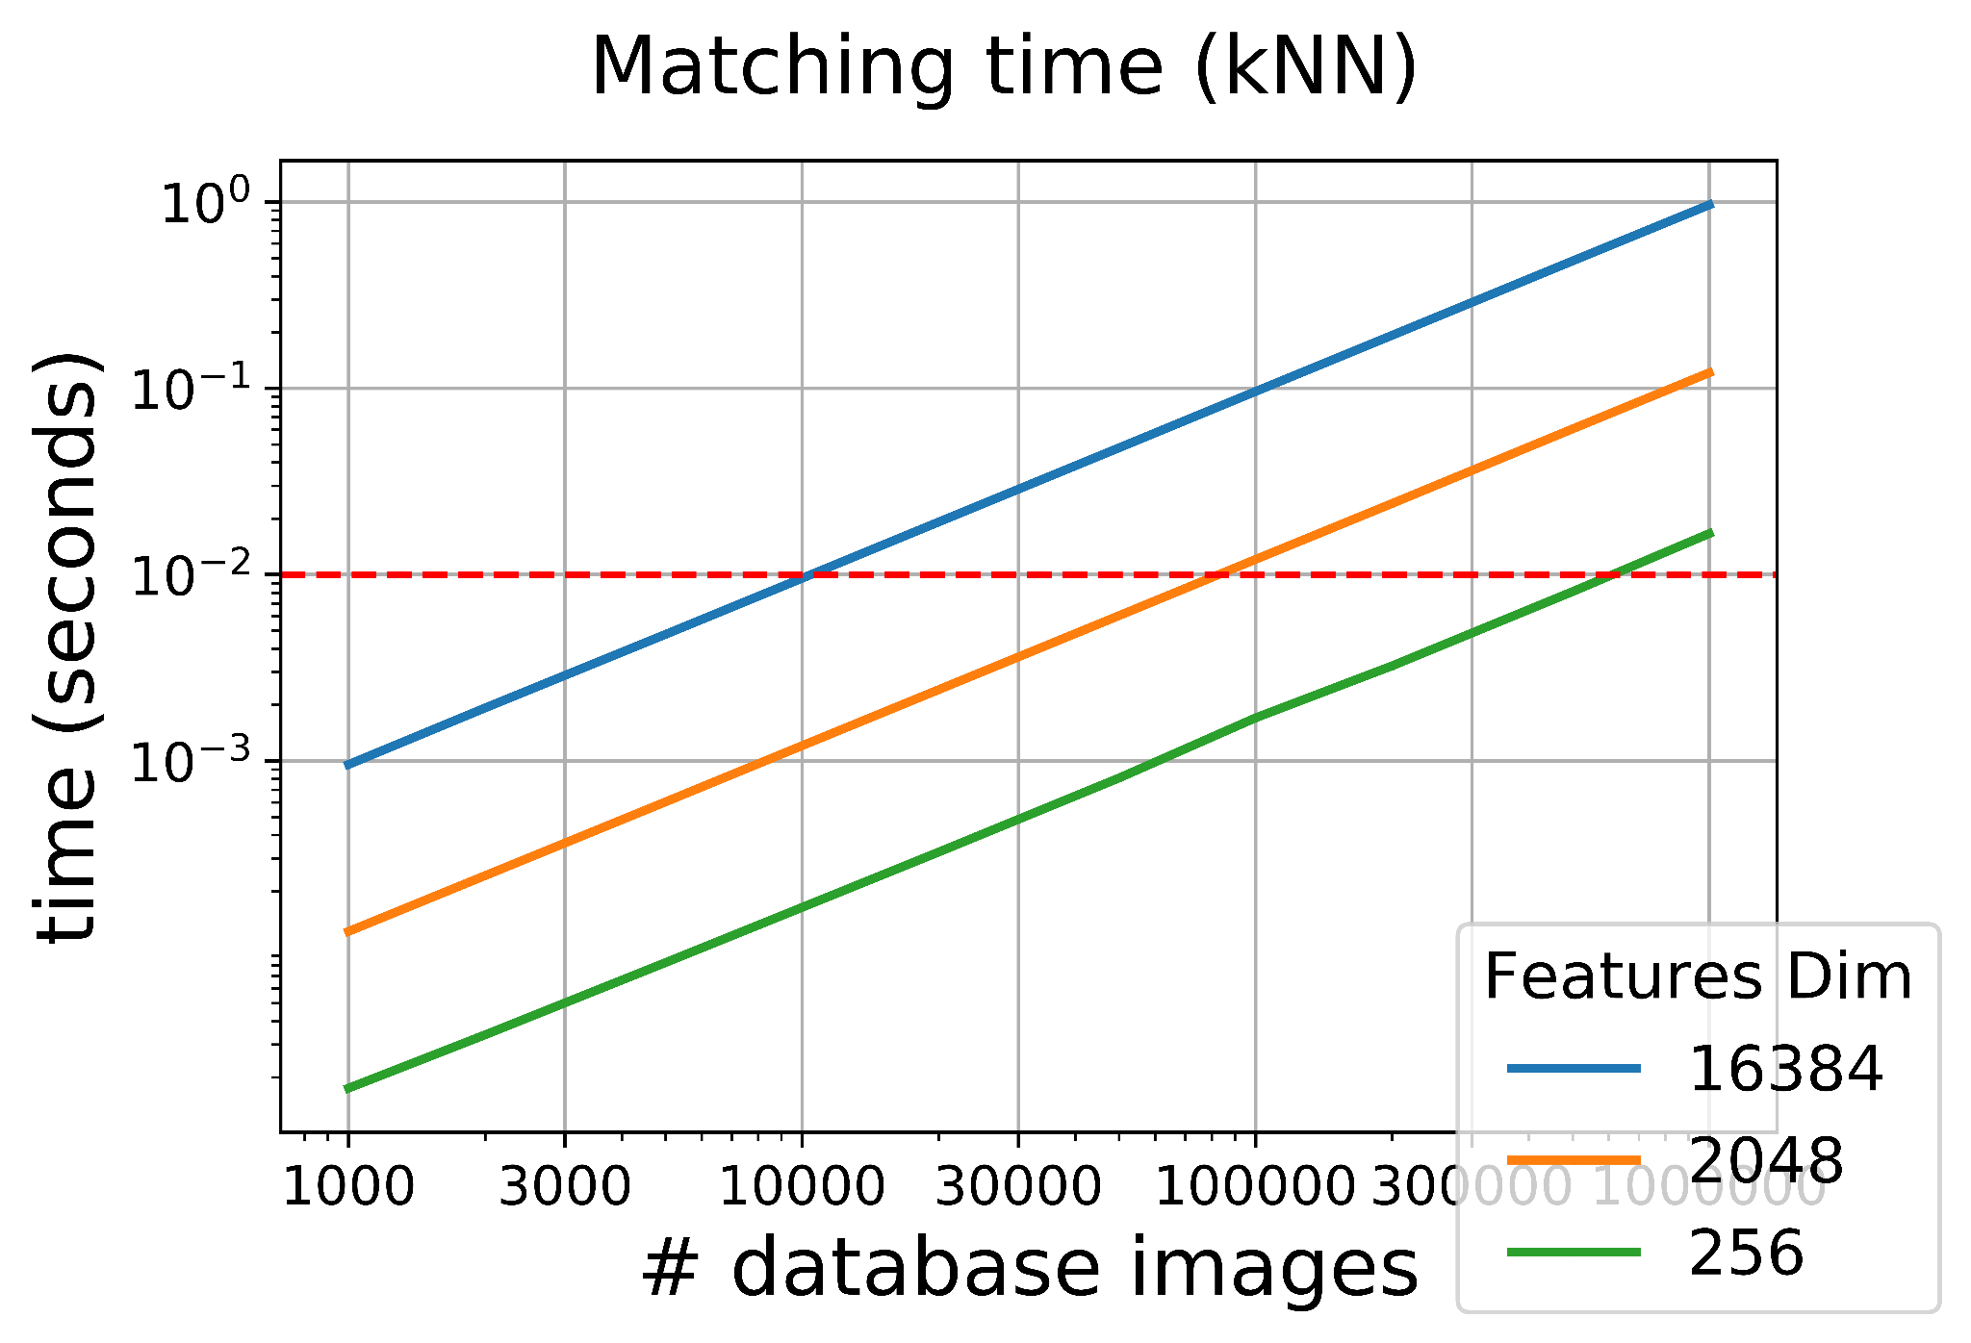
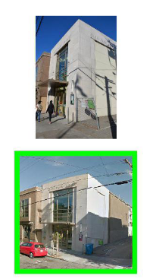
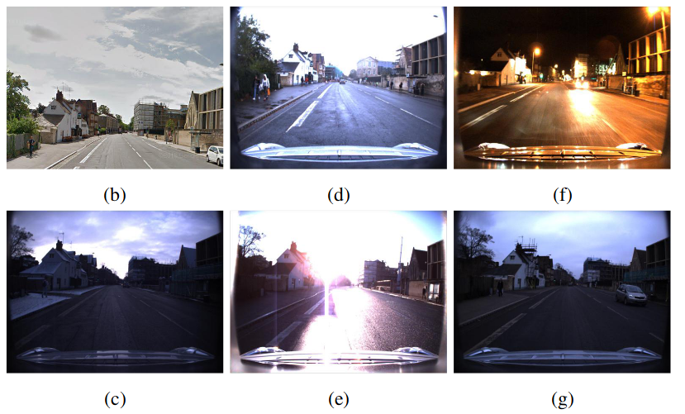
Challenges
Scalability, both at train and test time
Recognition becomes hard under perspective and/or lighting changes

Slide 7
Sub-projects
You will choose one of the two following sub-projects:
A) Image geolocalization through retrieval, by forcing the features of the same place to be near to each other, using a metric learning approach and losses like the triplet loss;
B) Classification for retrieval in image geolocalization, building on the idea that a neural network that is a good classifier for places produces informative features that can be used for image retrieval.

Slide 8
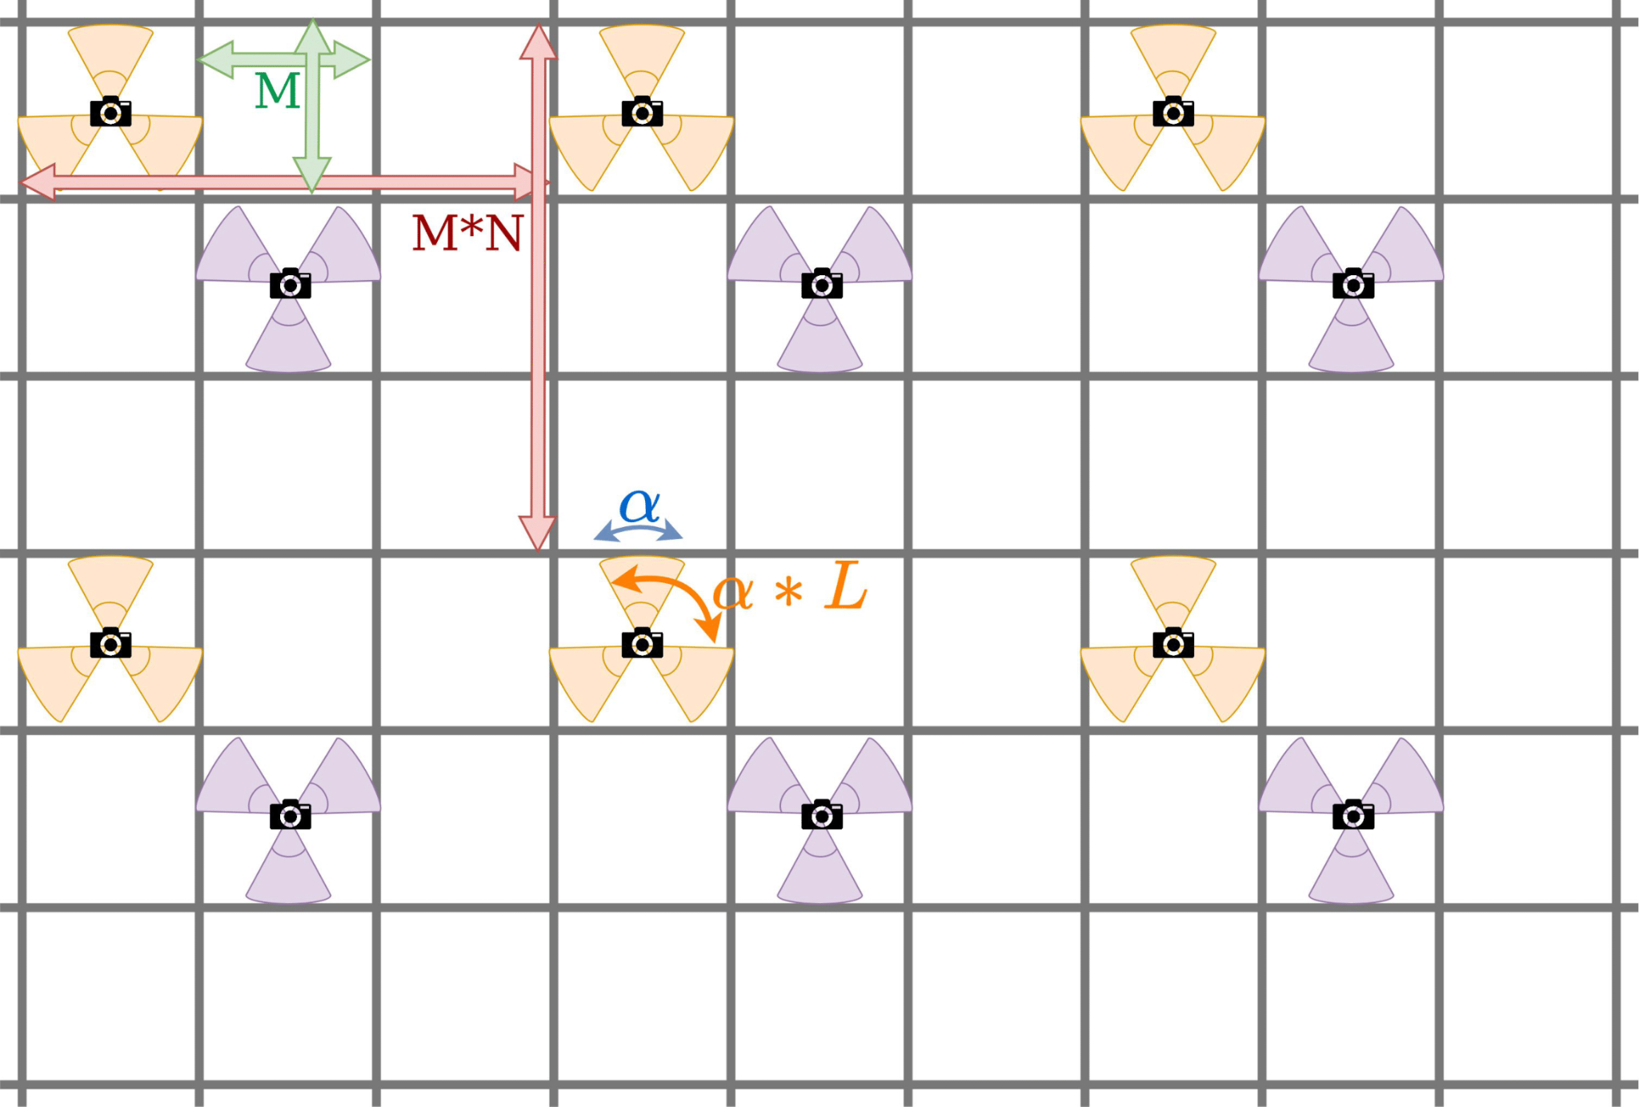
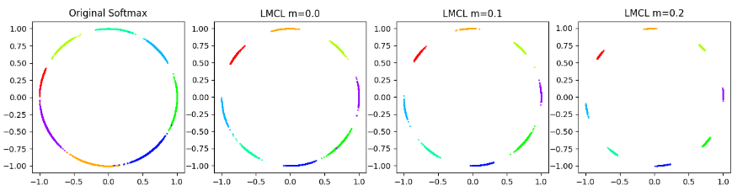
How to train Image Retrieval networks
Innovative approach
Split the dataset into classes, accounting for heading
as well as latitude and longitude
Train a set of large cosine margin losses,
that allow to learn discriminative embeddings

Slide 9
Challenges - Perspective and Domain shifts
Recognition is challenging under different weather/lighting conditions and/or perspective

Slide 10
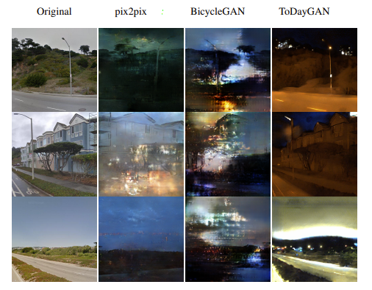
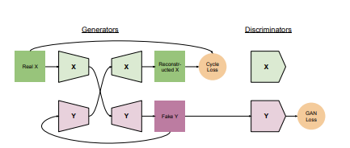
Example of previous year’s projects
Synthetic Images as Data Augmentation

Slide 11
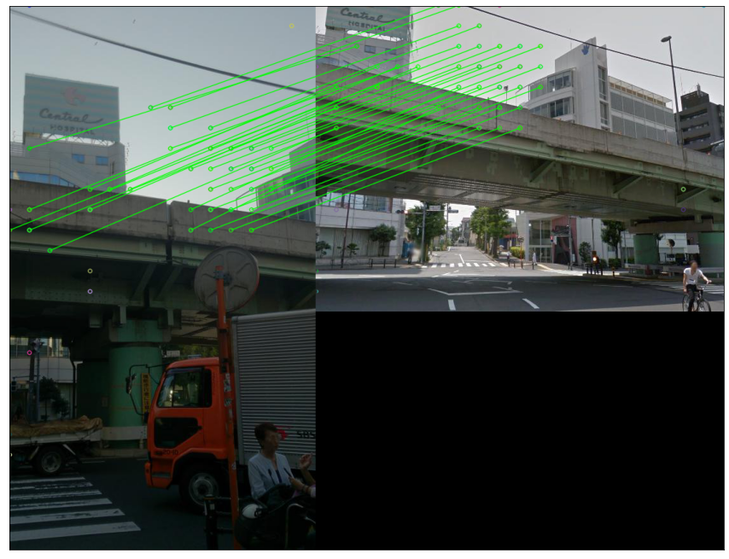
Example of previous year’s projects
Spatial verification

